Slide 1
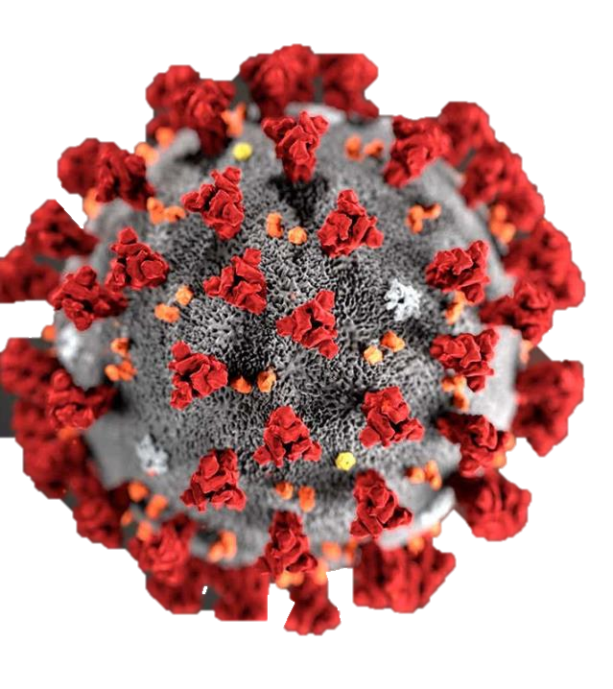
Infection Prevention:
COVID 19

Slide 2
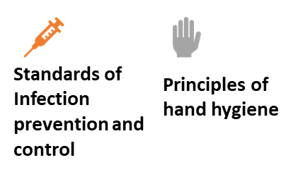
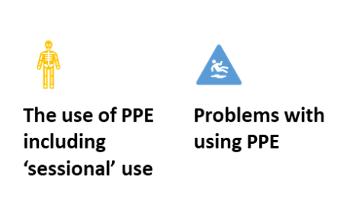





Slide 3
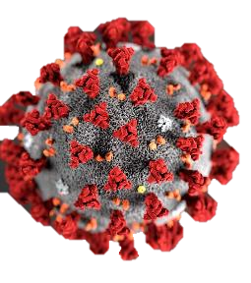
Covid 19: what is it?
Coronavirus disease (COVID-19) is an infectious disease caused by a newly discovered coronavirus (WHO, 2020)
COVID 19 infection is transmitted by respiratory droplets that are created by coughing and sneezing
General belief is that these droplets can travel in the air for about 2 meters and then fall onto surfaces
The virus can survive on surfaces including the skin for many days and be picked up by touching these surfaces and then touching the eyes, mouth or nose
Notes:
WHO 2020 https://www.who.int/health-topics/coronavirus#tab=tab_1

Slide 4
https://www.youtube.com/watch?v=UG8YbNbdaco

Slide 5
Covid 19: risk groups.
People at high risk (clinically extremely vulnerable)
Organ transplant.
Chemotherapy or Radiotherapy.
Targeted cancer treatments ( protein kinase inhibitors or PARP inhibitors).
Blood or bone marrow cancer.
Bone marrow or stem cell transplant in the past 6 months or are still taking immunosuppressant medicine.
Severe lung condition (such as cystic fibrosis, severe asthma or severe COPD).
Taking high level steroid medication.
Metabolic conditions (sickle cell).
Born with a serious heart condition and are pregnant.
People at moderate risk (clinically vulnerable)
70 or older.
Pregnant.
Lung condition that's not severe (such as asthma, COPD, emphysema or bronchitis).
Heart disease.
Diabetes.
Chronic kidney disease.
Liver disease.
Certain neurological conditions (such as Parkinson's disease, motor neuron disease, multiple sclerosis or cerebral palsy).
Taking low dose steroids.
Very obese (a BMI of 40 or above).
Notes:
People at high risk (clinically extremely vulnerable)
organ transplant
having chemotherapy or antibody treatment for cancer, including immunotherapy
having an intense course of radiotherapy (radical radiotherapy) for lung cancer
having targeted cancer treatments that can affect the immune system (such as protein kinase inhibitors or PARP inhibitors)
Blood or bone marrow cancer (such as leukaemia, lymphoma or myeloma)
Bone marrow or stem cell transplant in the past 6 months, or are still taking immunosuppressant medicine
Severe lung condition (such as cystic fibrosis, severe asthma or severe COPD)
are taking medicine that makes them much more likely to get infections (such as high doses of steroids)
Metabolic conditions (sickle cell)
born with a serious heart condition and are pregnant

Slide 6
COVID19: symptoms
Symptoms start 5 -11 days after exposure
Illness is similar to flu
Most people have fever and dry cough (rapid onset)
Most people have symptoms for 5 - 6 days
20% have more severe illness – from day 7
  ↑ Shortness of breath
  Lung inflammation
  Pneumonia
Common Symptoms of COVID-19
Fever >37.8ºC
Dry cough
Fatigue
Sputum
Shortness of breath
Muscle/joint pain
Sore throat
Headache
Hoarseness
Nasal discharge
New loss of taste and/or smell

Slide 7
COVID 19: identifying patients.
The most common symptoms of coronavirus (COVID-19) are recent onset of:
New continuous cough and/or
High temperature, above 37.8 degrees C and/or
New loss of taste or smell
Current guidance published 02-04-2020:
Assess each resident twice daily for the development of a temperature(≥37.8°C), cough or shortness of breath.
Immediately report residents with fever or respiratory symptoms to NHS 111.
If you have more than one resident with symptoms:
Inform the Health Protection Team (HPT) in your area. They may arrange testing of possible cases to confirm the existence of an outbreak.

Slide 8
COVID 19: suspected/positive case.
Isolate resident – this is the most important step:
    Ask the resident to clean their hands by washing it or use hand gel
    Place the resident in a room and close the door – reassure them
The isolation room for the suspected case:
If possible should have its own bathroom
If an enSite is not possible you should bring a commode into the room for the patient.
Transferring the resident with suspected COVID 19 to another room:
When transferring symptomatic residents between rooms, the resident should wear a surgical face mask
Staff should wear Personal Protective Equipment (PPE) – surgical mask, visor, disposable apron and gloves

Slide 9
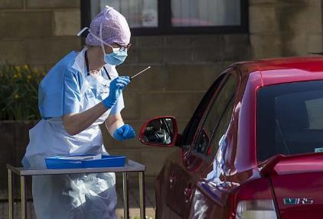
Staff with COVID-19
If you develop symptoms of a flu-like illness then DO NOT come into work and inform you manager:
  fever of more than 37.8ºC and/or new persistent cough and/or new loss of taste or smell
  other symptoms of respiratory infection
Self-isolate at home for 7 days from onset of symptoms
  Arrange to take a COVID-19 test
    within 3-4 days of start of symptoms
    if you are better and the test is negative your can return to work
  If your symptoms worsen contact NHS 111
If a member of your family develops symptoms
  Arrange for them to have a COVID-19 test (if possible)
  If this is negative you can return to work
  If no test or test is positive then self-isolate for 14 days
Staff at high risk of complications from COVID-19
  risk-assessment to manage if and where they can work

Slide 11
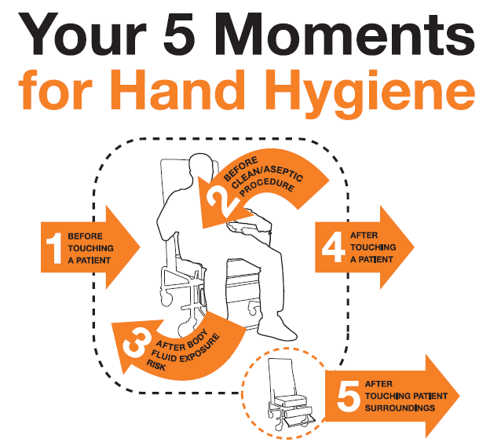
Hand hygiene: staff

Slide 12
Hand hygiene: staff
BEFORE | AFTER
Leaving home | Arriving at work
Food prep | Touching surfaces
Eating any food | Decontamination equipment
Eating snack | Handling waste
Taking a break | Using the toilet
Leaving work | After taking a break

Slide 13

Hand hygiene: Patients
Encourage residents to clean their hands
  After coughing/sneezing
  Before eating
  After toilet
Make hand wipes or alcohol gel easily available for
the resident to use

Slide 14
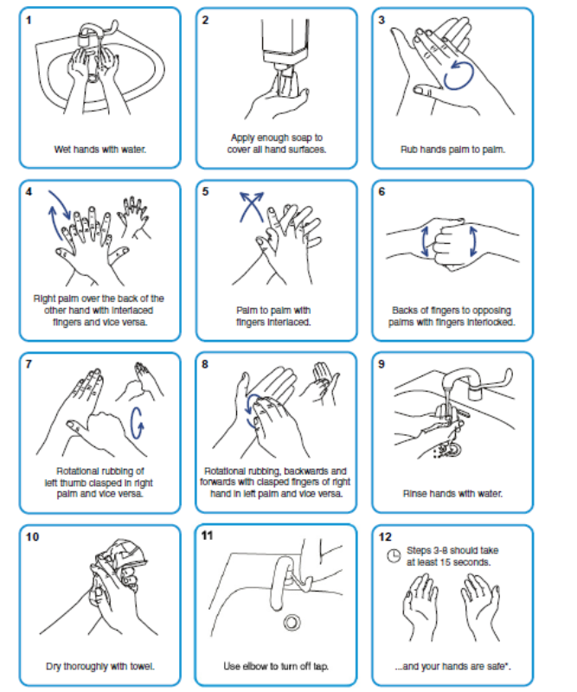
6 steps of hand hygiene
Take time to study all the steps in the poster.
The entire set of actions should not take less than 20 seconds.

Slide 15
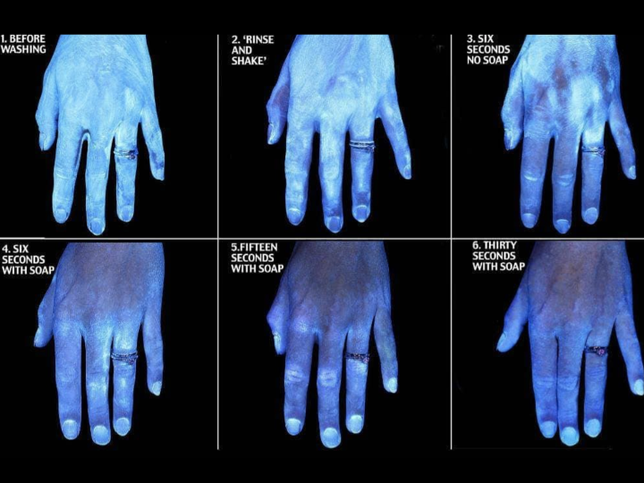
Effectiveness of handwashing

Slide 16

National hand hygiene policy
Bare below the elbows:
Short sleeves or long sleeves rolled up
No jewellery
One plain band ring
Simple nails
No long nails, no nail varnish, no long false nails
Cover cuts & abrasions
Waterproof dressing
Good skin care

Slide 17
https://www.youtube.com/watch?v=TGddyTW5eMc

Slide 18
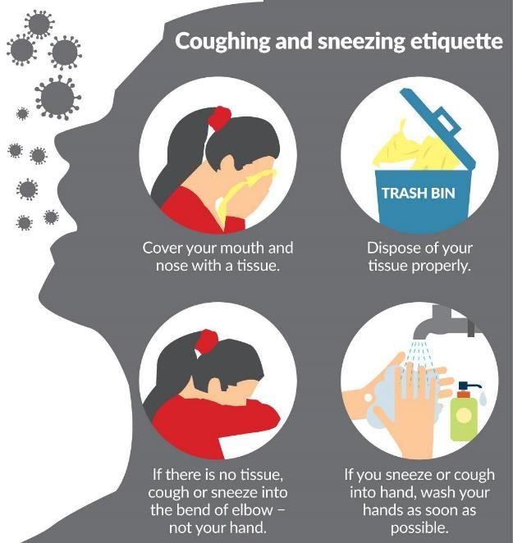
‘walking with a purpose’
Try to promote cough etiquette
Try to promote hand cleansing
  - offer patients hand wipes regularly
Try to guide the resident back to their room.
Clean high touch surfaces more frequently
  -handrails, door handles, tables etc

Slide 19
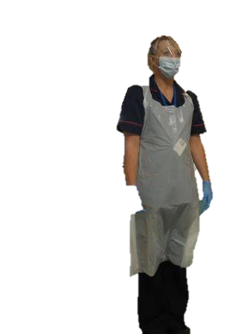
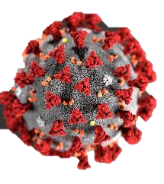
Managing contact between staff and residents
Residents
  If extremely vulnerable should be placed in single room and not share bathroom with other residents
  Symptomatic resident should wear surgical face mask (if possible) to transfer between rooms
Staff
  Where possible staff should be allocated to work with EITHER symptomatic or non-symptomatic residents
  Staff who have previously tested positive for COVID-19 should care for symptomatic residents (still use PPE)

Slide 20
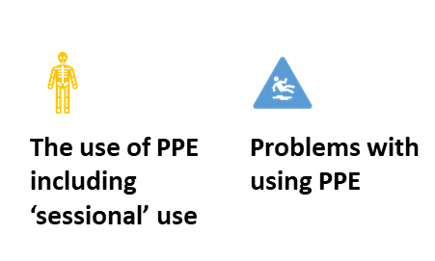

Slide 21


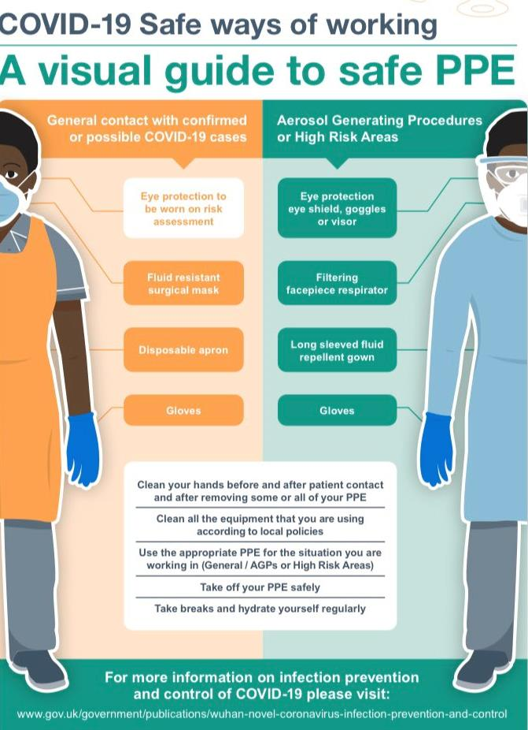
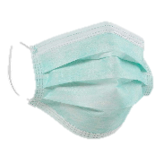
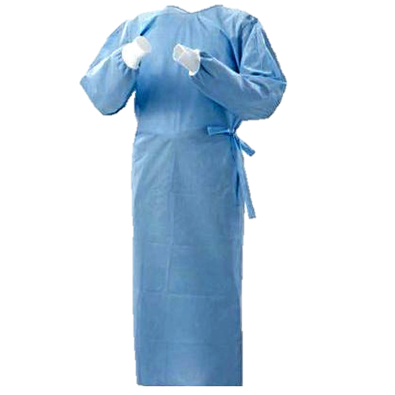

The correct use of PPE:

Slide 22
https://www.youtube.com/watch?v=7oVP0X9X28M&feature=youtu.be

Slide 23
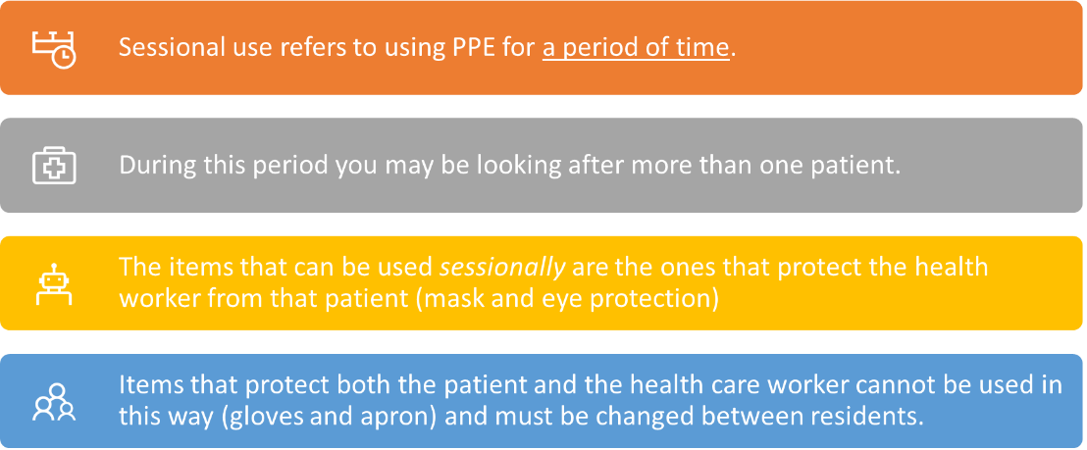
PPE: what is sessional use.

Slide 24
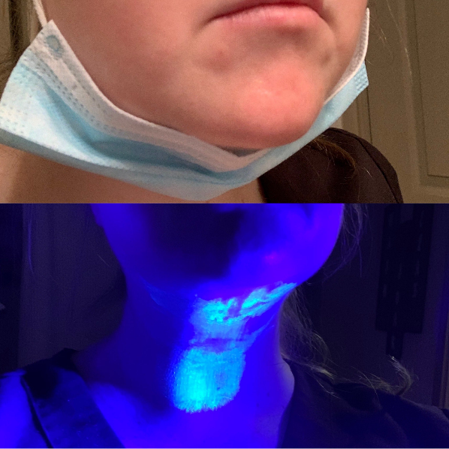
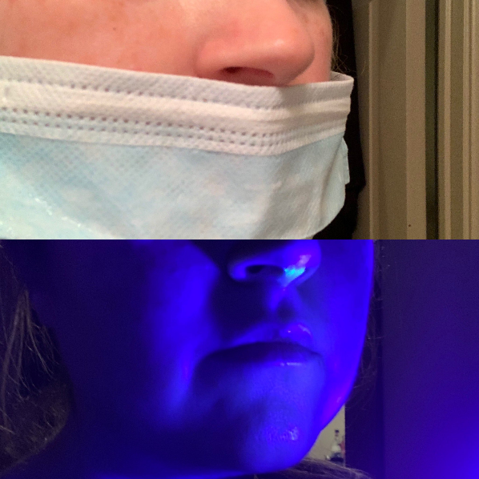
Problems with PPE

Slide 25



Slide 26

Laundry: Covid residents
Treat as infectious waste
  Place directly into alginate (dissolvable) bag
  Place this into an outer plastic bag
Bring laundry hamper close to room (do not take in)
Do not shake or sort linen
Do not put used linen on floor or other surfaces

Slide 27
Staff uniforms
Personal hygiene | Uniforms
Wash hands and forearms before leaving | Protect your uniform from contamination with plastic aprons
Wash hands again when arriving home | Change out of uniform before leaving work. Transport home in a plastic bag or old pillow case.
Shower as soon as you get home, including washing your hair | Wash uniforms in usual washing machine: Wash clothes at 60 degrees or higher. Use non-biological washing powder. Wash uniforms separately from other household items. Items should be then tumble dried and/or ironed.

Slide 28
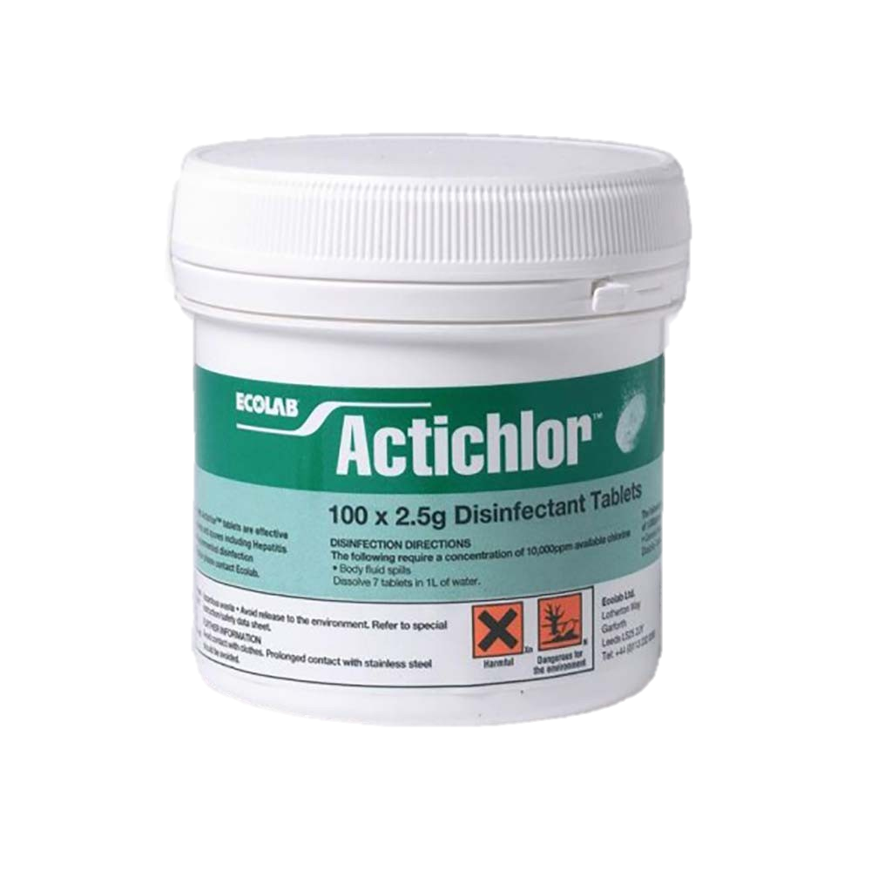
Cleaning
Regular cleaning throughout the home prevents surfaces becoming contaminated with virus
Open windows to allow fresh air to circulate
Use combined detergent/disinfectant solution for cleaning hard surfaces:
  Preferably 1000ppm chlorine disinfectant
  If another disinfectant (check efficacy with manufacturer)
Use detergent to clean soft furnishing (if likely to be damaged by chlorine disinfectant)
Discard items heavily contaminated by body fluids if they cannot be washed
Use disposable cloths
Launder mop heads or use disposable

Slide 29
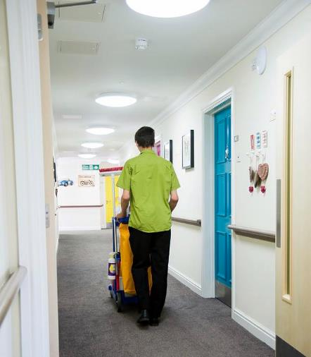
Cleaning
Ensure cleaning staff know what PPE they should wear in each area
Train cleaning staff in putting on & taking off PPE
Clean all surfaces in resident rooms
(especially high touch areas such as grab rails, bedrails, bathrooms)
Discard cleaning solution at a disposal point
(Clean mop handle & bucket)
Remove waste and linen for disposal/reprocessing
Remove PPE and wash hands

Slide 30
Cleaning: after death of a covid positive resident
Clean all surfaces
  high level windows, ledges and sills, curtain rails
  lower level windows, ledges and sills
  furniture, fixtures and fittings, en-suite rooms
  door handles, light switches, soap & towel dispensers
Clean all surfaces of mattress and bed
  Unzip mattress – check foam for strike through – replace if soiled
Mop hard floor surfaces
Shampoo carpet and fabric chairs
Discard waste (as clinical waste)
Place laundry in dissolvable bag and return to laundry

Slide 31
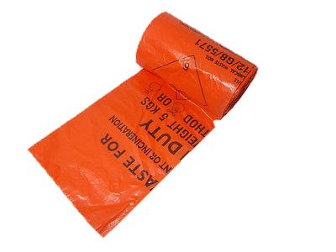
Waste from rooms of residents with COVID-19
Waste should be removed at least daily
Discard as clinical waste
If no clinical waste stream store securely for 72hrs and discard as household waste

Slide 32
Obtaining COVID 19 swab
Recommended sample:
Combined Nose and Throat swab - use single swab and send in one tube.
Note single nasal swabs will not be processed. Single throat swabs can be sent if necessary.
For Trust guidance on biosafety when taking samples refer to LTHT PPE Guidance -confirmed and suspected COVID-19 cases
Before taking sample label container with either ICE label or handwritten details of the patient’s name, date of birth and PAS or NHS number. Un-labelled samples are not able to be processed.
Ensure both ICE form and E28 request form are fully completed

Slide 33
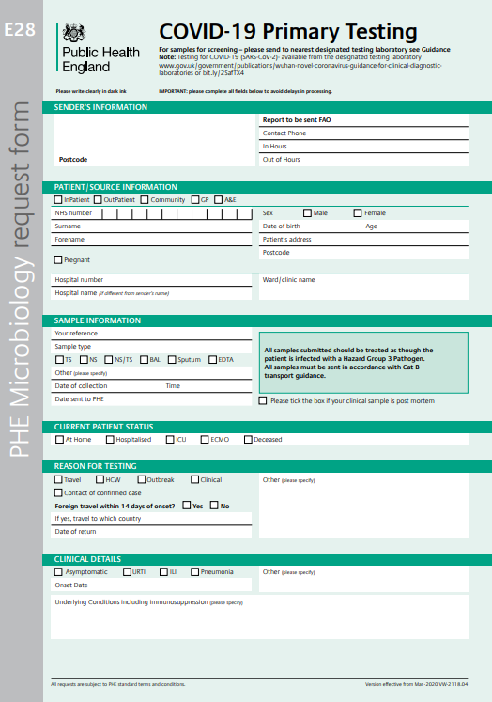
https://www.gov.uk/government/publications/testing-for-wuhan-novel-cov-2019-ncov

Slide 34
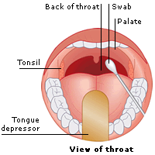

Obtaining COVID 19 swab
1. Open swab packet and use the swab to collect specimen from patient’s posterior pharynx and tonsillar area as indicated below. Swab both left and right sides. Avoid the tongue area.
2. Tilt the patients head back 70 degrees and using the same swab insert into nostrils whilst gently rotating swab. Insert until resistance is felt by the turbinates.
3. Rotate several times around the nasal wall and then repeat in the other nostril.
4. Place the swab into the eSwab liquid. Do not discard the liquid under any circumstance.

Slide 35

Obtaining COVID 19 swab
5. Break the swab at the point marked on the swab and screw on the lid.
6. Ensure the lid is fully tightened and secure.
7. Place swab inside a first specimen bag and then inside further bag with form attached.
8. Danger of infection stickers should be added to the forms. The form must not be sent in the bag next to the sample.
Note all samples for COVID-19 testing must be hand delivered to the laboratories. Do not send multiple requests in one bag as this may delay testing.
If samples cannot be sent immediately, they should be refrigerated.
If sputum samples or BAL or Nasopharyngeal aspirate (NPA) are required, please send in sterile universal containers.

Slide 36
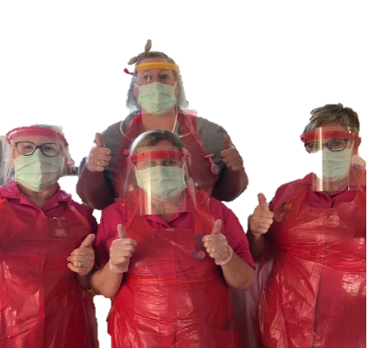
Top tips for trainers
All colleges need to complete the training.
- it may be helpful to monitor where certain members of staff go throughout the shift to identify ‘hot spots’ of staff.
It may take more than one teaching session for a person to grasp the full donning and doffing.
All trainers are to be supernumerary to act as PPE Champions, don’t be afraid to challenge incorrect practices.
Praise good practice , its important to keep moral up.

