Slide 1
Overview recovering from COVID Programme
Dr Sari Harenwall (clinical psychologist), Primary Care Wellbeing Service (PCWBS)

Slide 2
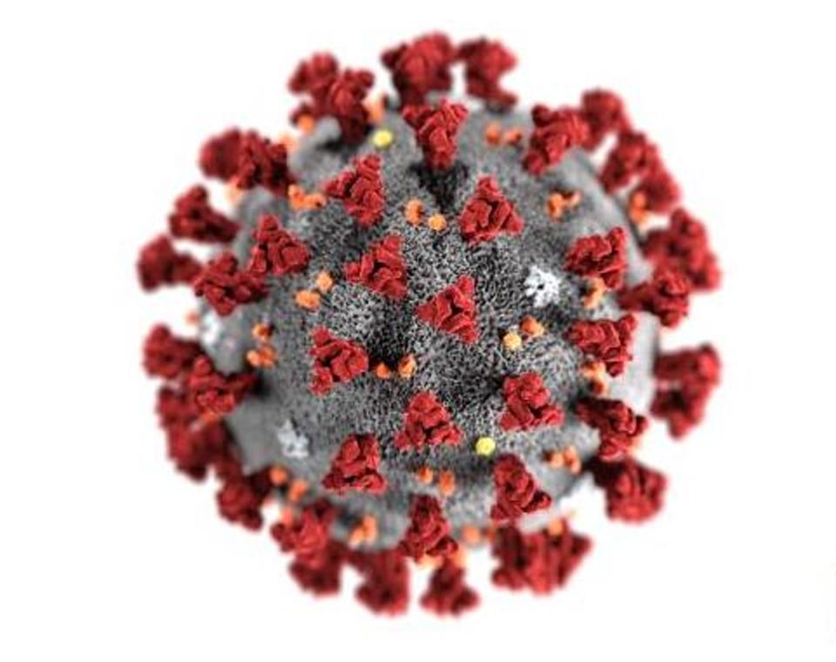
Background information about COVID
COVID disease is an infection caused by a coronavirus.
There are many types of coronavirus. Some affect the throat and the lungs. Illnesses from viruses range from the common cold and flu-like illnesses, to more severe diseases such as severe flu and pneumonia.
The full name of the virus is SARS-CoV-2. SARS stands for Severe Acute Respiratory Syndrome.
Some people have had very severe disease. However, others may not be aware they have had it. Scientists are trying to work out why it affects people so differently.
Regardless of you had severe symptoms, mild or no symptoms at all you can still suffer from Long COVID.
Up to 10% of people suffering with COVID-19 are expected to experience Long COVID

Slide 3
COVID-19 rapid guideline: managing the long-term effects of COVID-19 (NICE, 2020)
Definitions:
• Acute COVID-19: signs and symptoms of COVID-19 for up to 4 weeks.
• Ongoing symptomatic COVID-19: signs and symptoms of COVID-19 from 4 to 12 weeks.
• Post-COVID-19 syndrome: signs and symptoms that develop during or after an infection consistent with COVID-19, continue for more than 12 weeks and are not explained by an alternative diagnosis.
It usually presents with clusters of symptoms, often overlapping, which can fluctuate and change over time and can affect any system in the body. Post-COVID-19 syndrome may be considered before 12 weeks while the possibility of an alternative underlying disease is also being assessed.
COVID-19 rapid guideline: managing the long-term effects of COVID-19 (nice.org.uk)

Slide 4
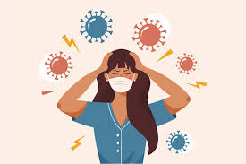
Long COVID literature review p1
Halpin et al., 2020
100 participants, 29 – 71 days post discharge from the hospital
New illness-related fatigue (72% of participants ICU group: 60.3% ward group)
Breathlessness (65.6% ICU group and 42.6% ward group)
Psychological distress (46.9% ICU group; and 23.5% ward group).
Greenhalgh, Knight, Court, Buxton, & Husain, 2020)
An estimate of 10% of patients who test positive for COVID-19 remain unwell following 3 weeks of being ill, and a smaller percentage for a period of months (based on the UK COVID Symptom Study)
Notes:
People treated in hospital will likely have some differences in symptoms. Most studies to date have focused on people in Hospital as they are easier to identify.

Slide 5
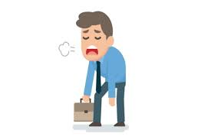
Long COVID literature review p2
Carfì et al., 2020
Patients were assessed after a mean of 60.3 days once the first COVID-19 symptom appeared
Only 12.6% of patients were completely free of any post COVID-19 symptoms,
55% had 3 or more symptoms, 32% had 1 or 2 symptoms
44.1% of patients revealed a worsened quality of life
53.1% of patients reported fatigue, 43.4% of patients reported dyspnea (shortness of breath), 27.3% reported join pain and 21.7% reported chest pain

Slide 6
How long does post viral fatigue last?
Recovery from post-viral fatigue varies from person to person, and there’s no clear timeline.
According to a small 2017 study in Norway, getting an early diagnosis may improve recovery.
A Prospective study in Australia in 2006 looked at people with glandular fever and other viruses.
Prolonged illness characterised by disabling fatigue, musculoskeletal pain, neurocognitive difficulties, and mood disturbance was evident in 29 (12%) participants at six months, of whom 28 (11%) met the diagnostic criteria for chronic fatigue syndrome.
The syndrome was predicted largely by the severity of the acute illness rather than by demographic, psychological, or microbiological factors.
A study of 233 SARS survivors, a year after the outbreak in Hong Kong (2009), over 40% had active psychiatric illnesses, 40% reported some degree of chronic fatigue and 27% met diagnostic criteria for chronic fatigue syndrome.

Slide 7
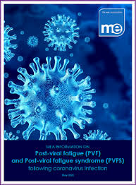
Common Symptoms in Post-Viral Fatigue
Fatigue and exhaustion
Sleep disturbance
concentration or memory problems
sore throat
headache
swollen lymph nodes
unexplained muscle or joint pain
COVID specific symptoms
Loss of taste and smell
Breathlessness

Slide 8
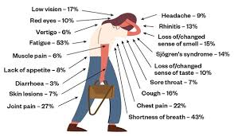
Common symptoms of ongoing symptomatic COVID-19 and post-COVID-19 syndrome (NICE, 2020)
Respiratory symptoms • Breathlessness • Cough
Cardiovascular symptoms • Chest tightness • Chest pain • Palpitations
Generalised symptoms • Fatigue • Fever • Pain
Neurological symptoms • Cognitive impairment ('brain fog', loss of concentration or memory issues) • Headache • Sleep disturbance • Peripheral neuropathy symptoms (pins and needles and numbness) • Dizziness COVID-19Delirium (in older populations)
Gastrointestinal symptoms • Abdominal pain • Nausea • Diarrhoea • Anorexia and reduced appetite (in older populations)
Musculoskeletal symptoms • Joint pain • Muscle pain
Psychological/psychiatric symptoms • Symptoms of depression • Symptoms of anxiety
Ear, nose and throat symptoms • Tinnitus • Earache • Sore throat • Dizziness • Loss of taste and/or smell
Dermatological • Skin rashes
Image source: Source: JAMA 2020;324(6):603-605

Slide 9
Summary of early survey data
19 participants completed survey prior to the 7 week recovering from COVID course.
12/19 experienced breathlessness
9/19 experienced throat sensitivity
17/18 reported a decline in overall health averaging at a 43% decline
16/16 experienced an increase in fatigue with an average of 7/10 (10 being the worst).
12/14 experienced increased problems with appetite
7/14 Had unwanted memories of the illness
6/16 experienced unwanted dreams about the illness
6/16 reported avoidance of thoughts and feelings
7/16 reported bowel problems
16/17 reported concentration problems
13/16 reported short-term memory problems
9/18 stated that their family had noticed a change in communication.
9/19 people reported negative impact on ability to work with several participants on long-term sick

Slide 10
Whole Systems Approach
Movement & energy conservation.
Activity Management
Stress and how to respond
Optimising breathing
Making the most of your diet
Optimising Sleep
What do we mean by a whole systems approach?
Why a whole systems approach?
Making changes – ripple effect, keeping it small

Slide 11
Recovering from COVID-19 course Overview
Understanding COVID19 and post-viral fatigue.
Importance of sleep and how to improve it.
Sleep hygiene and strategies.
Optimising your diet
Overview of research and meal suggestions to optimise energy levels and overall health.
Activity management
Pacing and grading. Learning how to optimise energy through regular rest periods.
Movement & energy conservation
Learning about the impact of physical movement including exercise, dysfunctional breathing and how to progress.
Stress management
Learning about the body’s stress response and how to calm it down with evidence based techniques.
What next?: planning for the future
Managing setbacks, signposting for continued support.

Slide 12
How to refer in to the programme
The course is delivered virtually using Microsoft Teams (free to download)
Lead by a Multidisciplinary team consisting of a Psychologist, Physiotherapist, Occupational Therapist, Dietitian and Personal Support Navigator.
If you would like to register for the course, contact the team via primarycarewellbeingservice@bdct.nhs.uk
Course dates
Wednesdays, 1-2PM, 20th January to 3rd March 2021
Tuesdays 1-2PM, 16th February to 30th March 2021
Wednesdays,1-2PM, 10th March to 21st April 2021
Please contact the team for further dates.

Slide 13
Long COVID Resources
Managing Long COVID symptoms:
Post-Covid-Fatigue-Syndrome-and-MECFS-September-2020.pdf (meassociation.org.uk)(meassociation.org.uk)
Your COVID Recovery | Supporting your recovery after COVID-19
Return to work guidance:
longCOVID_guidance_03_small (fom.ac.uk)

Slide 14
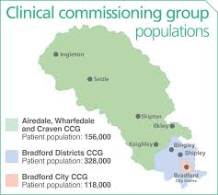
Are you supporting people with Long COVID?
Mapping exercise
As part of our work we are in the process of mapping services who formally or informally supports people with Long COVID, this can include primary/secondary care, social and health care services, voluntary services etc.
Please get in touch if you believe your service fits this description.

Slide 15
Thank You
Any questions?
Contact:
Mobile: 07548 702818
Email: sari.harenwall@bdct.nhs.uk or
primarycarewellbeingservice@bdct.nhs.uk
Dr Sari Harenwall
Senior Clinical Psychologist
CFS/ME and COVID Rehab Clinical Lead
Primary Care Wellbeing Service

