Slide 1
Winter Pack
for
Care Homes
2025/26

Slide 2
Introduction
Across Bradford district and Craven our aim is to keep people happy, healthy at home.
We have a range of services that can support people at home (including Care Homes) to avoid unnecessary hospital admissions or attendance at emergency departments
This Winter pack has been developed to raise awareness of the range of services and support that is available to Care Homes across Bradford district & Craven. Please print the pages out and display them within your Care Home as appropriate. Ensure you also print the poster out with the QR code so staff can easily access this resource online.
There is also information on how you can support our wider health and social care teams to reduce lengthy hospital stays and support people to return to their usual place of residence as quickly and safely as possible.

Slide 3
Hospitals are not always the best places for older people
They could have worse outcomes associated with hospital admissions including increased frailty, confusion, and a decline in function of the body due to inactivity

Slide 4


Concerned about a resident?
Accessing the right response at the right time for people living in Care Homes
Telemedicine provides you with a 24/7 clinically led service that not only offers advice, support and guidance but can also directly refer you into the Urgent Community Response or Virtual Ward if required

Slide 5

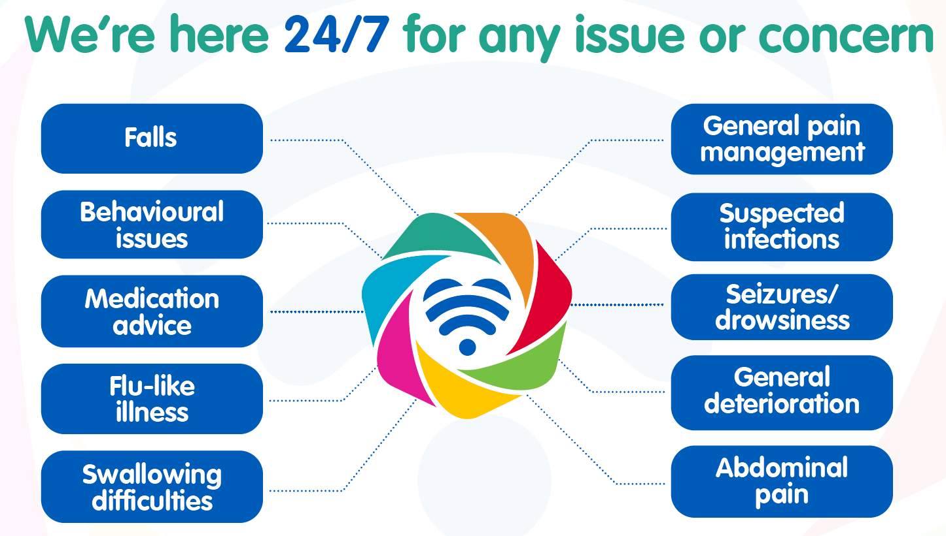
Check your internal policies and decision trees – do they refer to Telemedicine as the first point of contact?

Slide 6

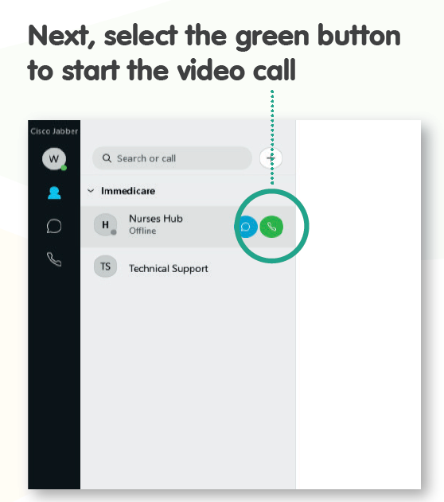
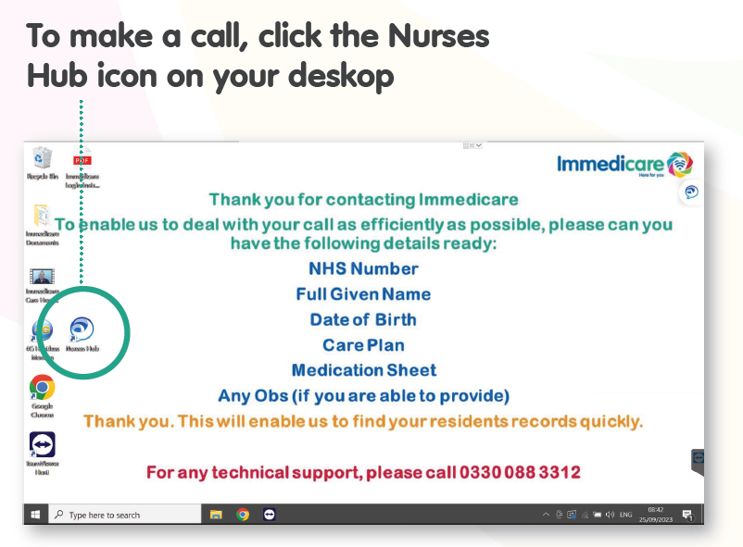
How to use Telemedicine
Ensure your care home laptop is fully charged and staff know where to find it when needed!
For technical support please call 0330
088 3312

Slide 7

Benefits of using Telemedicine
Have a question you can’t answer?
Prompt referral to other services including Urgent Community Response teams where face-to-face multi-disciplinary assessments and interventions may be offered within the Care Home.
Reduction in onward referrals and hospital attendance:
  Sending a resident into hospital can have a detrimental effect as it can increase confusion, increase infection risks, result in delays in treatment, increase the risk of deconditioning and increased falls
  No requirement to release staff to escort residents to hospital
Worried about a resident and need support?

Slide 8
Even if someone has already dialled 999, you can still contact Telemedicine as they could take-over before an ambulance arrives!
If your resident has a fall…
88% of residents remain in their care home post-fall when being assessed through the Telemedicine Service
Telemedicine provides you with virtual face-face access to a team of senior nurses, based within the Digital Care Hub. Assessments of residents who have fallen and the development of a falls risk assessment and prevention plan can be carried out remotely.
If the person has suffered a minor injury from the fall and requires treatment that can be carried out within the Care Home, the Telemedicine service will be able to refer you onto other services such as Urgent Community Response.
Our Urgent Community Response (UCR) service provides a two-hour response to people who are at risk of admission (or re-admission) to hospital due to a ‘crisis’ and are likely to attend hospital within the next two to 24 hours without intervention to prevent further deterioration and to keep them safe at home.
We also have established pathways in place with YAS where any calls received from Care Homes that are classified as Category 3 or Category 4 will be routed from 999 to the Telemedicine Service to see if we can support residents and avoid an unnecessary attendance to hospital.
Save time, contact the Telemedicine Service before calling 999, unless it’s an emergency (e.g. fracture or severe bleeding).

Slide 9

Falls – useful resources
Bitesize videos
Watch our bitesize videos delivered by Stephen Pugh, Falls Prevention Lead at Bradford District Care Trust (click on the links below):
Vision and Footwear
Strength, Balance & Environment
How cold weather affects older people – a video by Age UK:
Click Here
Become a Falls Fighter – check out this free 20 minute training resource that can be delivered to your staff to raise awareness of falls prevention:
Free Fall Prevention Course - RoSPA

Slide 10
Preventing Falls in Care Homes
Top tips:
Conduct Regular Risk Assessments
Assess their medical history, medications, mobility and cognitive function.
Create a Safe Environment
Remove clutter, secure loose rugs and ensure that furniture is arranged to allow clear, wide pathways. Install non-slip flooring in high-risk areas like bathrooms and kitchens.
Provide Adequate Lighting
Ensure that all areas, especially hallways and staircases are well-lit. Use night lights in residents’ rooms and bathrooms to help them navigate safely during the night.
Grab bars in bathrooms and handrails in hallways and staircases provide necessary support and stability for residents as they move around the care home.
Install Grab Bars and Handrails
Have a clear plan in place for responding to falls. This includes providing immediate assistance, assessing the resident for injuries and documenting the incident. Review each fall incident to identify causes and implement measures to prevent future falls.
Implement a Response Plan

Slide 11
Preventing Falls in Care Homes
Top tips:
Monitor Medications
Regularly review residents’ medications with a healthcare provider to reduce the risks of falls due to side effects like dizziness or drowsiness.
Promote Physical Activity
Engage residents in regular physical activity to improve strength, balance and co-ordination. Always supervise these activities to ensure safety.
Ensure that residents wear well-fitting, non-slip shoes. Avoid slippers and loose-fitting footwear that can cause trips and falls. Regularly check the condition of residents’ shoes and replace where necessary.
Provide Proper Footwear
Encourage the Use of Assistive Devices
Encourage the use of walkers, canes and other assistive devices as prescribed by their healthcare providers and ensure they are in good condition and adjusted to the user’s height.
Provide ongoing training for staff on fall prevention strategies and how to assist residents safely. Educate residents about the importance of fall prevention and encourage them to report any hazards they notice.
Educate Staff and Residents

Slide 12

What is an Urgent Community
Response service?
Our Urgent Community Response (UCR) service provides a two-hour response to people who are at risk of admission (or re-admission) to hospital due to a ‘crisis’ and are likely to attend hospital within the next two to 24 hours without intervention to prevent further deterioration and to keep them safe at home.
Nursing and residential homes will need to contact the Telemedicine Service (TMS) in the first instance for triage/advice/support/guidance regarding referral into the UCR service and if required the TMS will refer directly into the UCR service
Interventions will be time limited between 24-72 hours and will cover a range of elements:
(Step up to Virtual Ward if ongoing interventions required post 72hrs.)
Including:
Comprehensive Geriatric Assessment
Diagnostics point of care testing e.g., bloods, urine
Medical/nursing/therapy interventions
Prescription and/or administration of medication for pain or symptoms relief
Catheter care to relieve immediate discomfort
Medication review
Social care support (BEST)
IV therapy
The person is:
Over 18 years
Registered with a GP in Bradford district & Craven
Experiencing a crisis which can be defined as a sudden deterioration in their health and wellbeing
Require an MDT approach
Able to have a health and social care needs met safely within 2 hrs at home

Slide 13
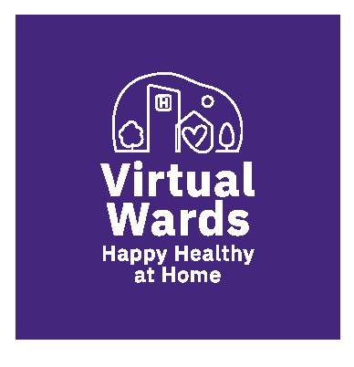


What is a Virtual Ward?
After a period of up to 72 hours a person may be discharged from Urgent Community Response (UCR) with no further interventions needed or referred into wider community teams for some additional support.
If there is a need for ongoing treatment that can still be provided in their usual place of residence, they could be stepped up into our Virtual Ward service.
Our Virtual Wards support patients, who would otherwise be in hospital, to receive the acute care and treatment they need in their own home (including Care Homes). This includes either preventing avoidable admissions into hospital or supporting early discharge out of hospital.
Nursing and residential homes will need to contact the Telemedicine Service (TMS) in the first instance to seek triage/advice/support/guidance regarding referral into a VW service and if required the TMS can refer directly into the VW service.
Benefits of using Virtual Ward:
Increased patient choice and personalised care, allowing patients to be treated in a more comfortable home environment.
Caring for people in their own homes can contribute to fewer hospital-acquired infections, falls and complications.
Reduced emergency department (ED) presentations and hospital admissions through the provision of timely multidisciplinary care.

Slide 14




What actions can you take to be more pro-active with the care of your residents?
Ensure all residents are up to date with immunisations and non are missed such as Flu / Covid
Ensure all resident’s contact details are up to date
Work with your PCN/GP practices to ensure long term condition checks and medication reviews have occurred in the last 12 months
Ensure all residents have ReSPECT plans in place and you have the most up to date version

Slide 15



What if my resident is deteriorating?
Deterioration is when a resident moves from their normal clinical state to a worse clinical state.
This increases their risk of illness, sepsis, organ failure, hospital admission, further disability and even sometimes death.
To improve resident outcomes, it’s important to focus on:
Why do we need to spot deterioration early?
Responding early will ensure that the resident receives ‘The right care, at the right time by the right person’
Prompt treatment and care will enhance the resident’s comfort and promote recovery
We can avoid some hospital admissions which may not be in the resident’s best interest or wishes
Recognition – Spot the early signs that a resident is deteriorating
Response – Think what actions do I need to take?
Communicate – Escalate your concerns and ask for help from other
healthcare staff Think: Telemedicine

Slide 16



Older People’s Response Team
Maintaining people’s mental health in care homes is just as important as meeting their physical health needs. The Older People’s Response Team can support you with:
The Older People’s Response Team can be contacted
7 days a week, 9am-9pm
Please email: OlderPeoplesResponseTeam@BDCT.NHS.UK
Tel: 07808 847172
Advice and signposting
Support with behaviours which challenge
Mental health support
Response within 48 hours as not a crisis service

Slide 17



Recognition of Life Extinct (RoLE)
When one of your residents dies there are several processes which need to take place. One of them is confirming that your resident has died called Recognition of Life Extinct (RoLE). This allows the funeral director to take their body to a chapel of rest, and for the GP to complete the death certificate.
Who can undertake RoLE and how can you support the Telemedicine Service to carry out RoLE virtually?
For the nurse in the Telemedicine Service to undertake RoLE virtually, they will require you to support them. They will still be the person responsible for undertaking and recording the outcomes of the task but will need you to act as their eyes and ears. To support the nurse in the Telemedicine Service to carry out RoLE you will need:
Registered Nurses, such as District Nurses and those working in the Telemedicine Service can carry out the RoLE process for residents where their death is expected.
An expected death is one where the resident was on the GP’s Gold Standards Framework (GSF-palliative care) register and had a ReSPECT form with a DNACPR decision. They do not need to have seen a GP in the last 28 days for death to be expected.
A nurse can carry out the process either over video link with your support to help them, or in person.
They will ask you to check if the resident is breathing, if they have a pulse, if they have any eye movement and if their pupils are fixed and dilated. Once this has been done, the Telemedicine Service will undertake the required next steps to confirm RoLE so the Funeral Director can take the body to the chapel of rest and the GP can complete the death certificate.
Nursing Homes may undertake RoLE independently and this can continue however, support is also available for staff working within Nursing Homes from the Telemedicine Service too if staff feel they would value additional support.
A Pen
A Torch
Appropriate
personal protective clothing
If you do not feel confident or able to help the TMS with this process, you do not have to and should not feel pressured into doing this task.

Slide 18




Moving between hospital and home (including care homes)
It is recognised that there will be times when it will be appropriate for your resident to attend an emergency department or be admitted into hospital.
Good communication is essential when residents are moving between hospital and their usual place of residence.
Without it, people can experience:
Unmet care and support needs
Avoidable hospital readmissions
Unnecessary long stays in hospital which can lead to further deterioration and risk of infection.

Slide 19







What you can do to support the transfer of residents in and out of hospital
Before admission:
Please prepare any relevant care plans and ReSPECT documentation, equipment, medication, glasses, dentures, hearing aids etc.
Please make this information/items easily accessible to the health and care staff involved in the transfer to hospital and that they are identifiable to avoid them getting lost.
If you have a Red Bag,
make sure it’s readily available
At admission:
Please provide the admitting team with all the information/personal items as above
Discharge:
Please stay connected with the hospital to understand when your resident will be ready to come home
Once your resident is medically fit for discharge or if you are taking a new admission from hospital into your Care Home, please review assessments and confirm if you’re able to accept the resident in a timely manner.
This will help to minimise any risk of harms to your resident, avoid any unnecessary delays and free up a bed for someone with a more urgent need.

Slide 20
Other helpful resources….
Care Home Handbook
We have recently updated and refreshed the Care Home handbook which is a resource that provides information on the local practices, top tips, useful links and contacts across Bradford District.
You can access the handbook here: Care Home Handbook
Bradford Care Association Quality Workshop Resource Pack
In September 2025 BCA held a Quality Workshop – Quality in Practice: Enhancing Health in Care Settings. The session covered a range of topics (below) and a resource has been developed which can be requested here: Quality Workshop Resource Pack
Falls
End of Life (EOL) care
Continence and skin integrity
Medication
Tissue viability and nutrition
Mental health
Enhanced health in care homes
Integrated neighbourhood working
Delegated health tasks

Slide 21



Staying connected via Bradford Care Association
Are you or your management team part of the BCA’s Managers WhatsApp Group?
If not please email BCA with names, numbers, and positions in the company and you will be added to the group. The WhatsApp group is a great place where providers are updated on current guidance and updates. It also allows providers to ask questions, get quick responses, and can help one another out.
Do you attend the BCA fortnightly Provider Update Meetings?
The BCA Provider Meetings take place fortnightly on Tuesday’s from 10:30 – 11:30 via MS Teams. The meeting will include updates, guidance, discussions of good practice and will allow the opportunity for Providers to discuss any issues they may have. Email BCA requesting Meeting calendar invitation. Please see below for MS Teams Joining details:
Click here to join the meeting
Meeting ID: 317 448 984 294
Passcode: nvFca6
Contact BCA at admin@bradfordcareassociation.org
Are your Activity Coordinator's part of the Activity Coordinator Network?
The network enables Activity Coordinator's to support one another, showcase ideas and share contacts and resources via monthly meetings and WhatsApp Group. To join the network please email BCA.

