Slide 1
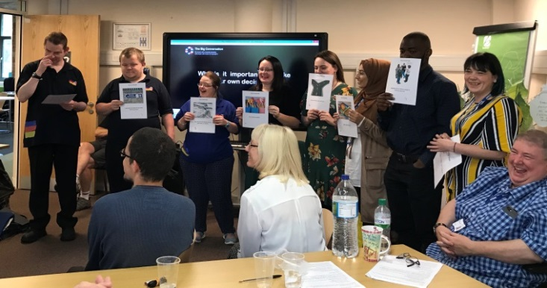
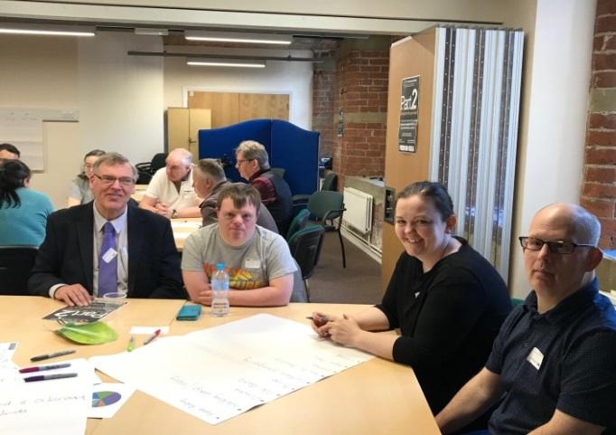
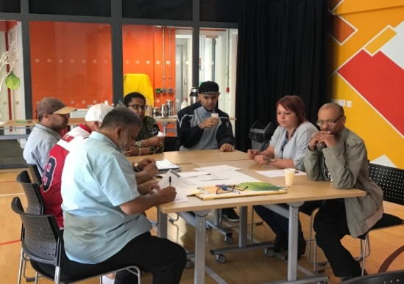
Health and Care (people with) Learning Disability Champions
What we want to do

Slide 2
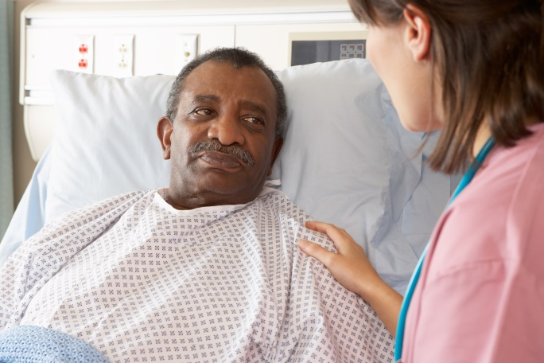
Working with you
We want :
People with learning disabilities to have the best care
To hear your experiences of care both good and bad
Make the care you receive right for you and other people with a learning disability

Slide 3
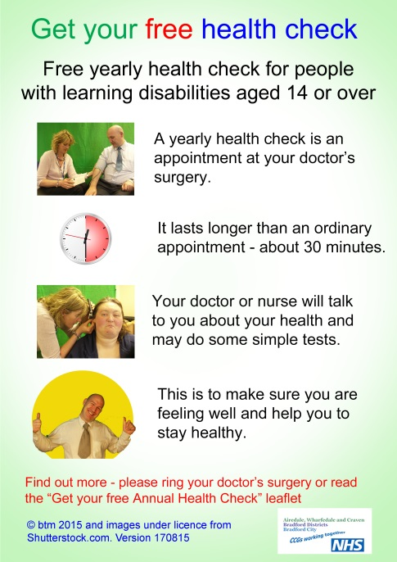
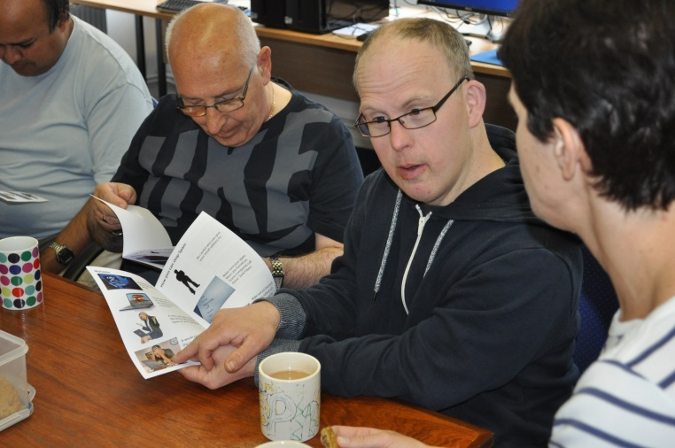
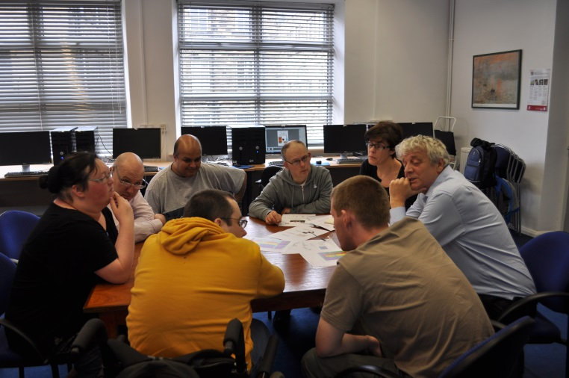
Working with you
Involve you from the beginning when we are planning new services
Make sure we include you in all our ideas
Make sure we listen to your experience of health services

Slide 4
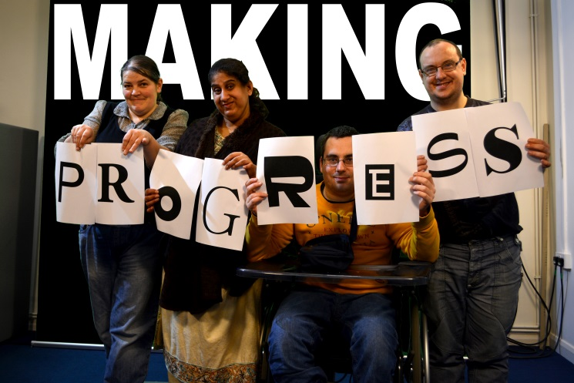
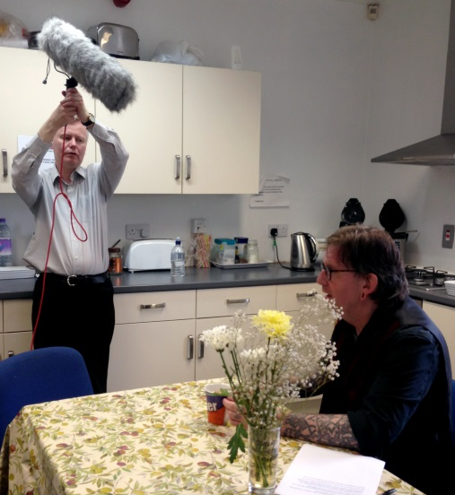
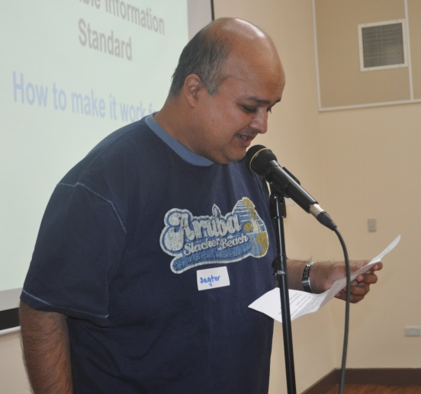
How you can help make things better
Join the health and care champions project
Do training with us if you need to; to make sure you feel comfortable going to meetings and doing presentations

Slide 5
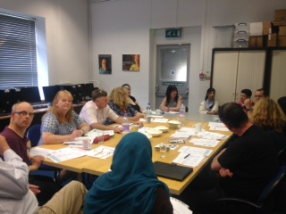
Tell us of your lived experience
Work with other health and care champions and people with learning disabilities you know, to plan a list of what you think is most important
Offer training to health and care organisations and people who work for them

Slide 6
Things that are important to everyone
Cancer Awareness (making sure that people understands why going for tests is important)
Early Intervention and Prevention (this means making sure people have the right information and help to, when possible, stop them becoming ill)
Planned Care (this means things that you might do, go into hospital, have an appointment about a condition you have with a doctor or specialist or if you are having a baby)
Promoting the needs of people with learning disabilities (speaking to health and care organisations and people who work for them to make sure they understand what you need)

Slide 7
Part of feeling healthier and happier is about looking after yourself, this is called Self Care
WYHHCP want to support you to be able to have the information and confidence in yourself to live the best life you can
How can they do this?
Making sure your care is suitable and made to work for you . This is called Personalisation

